Slide 1
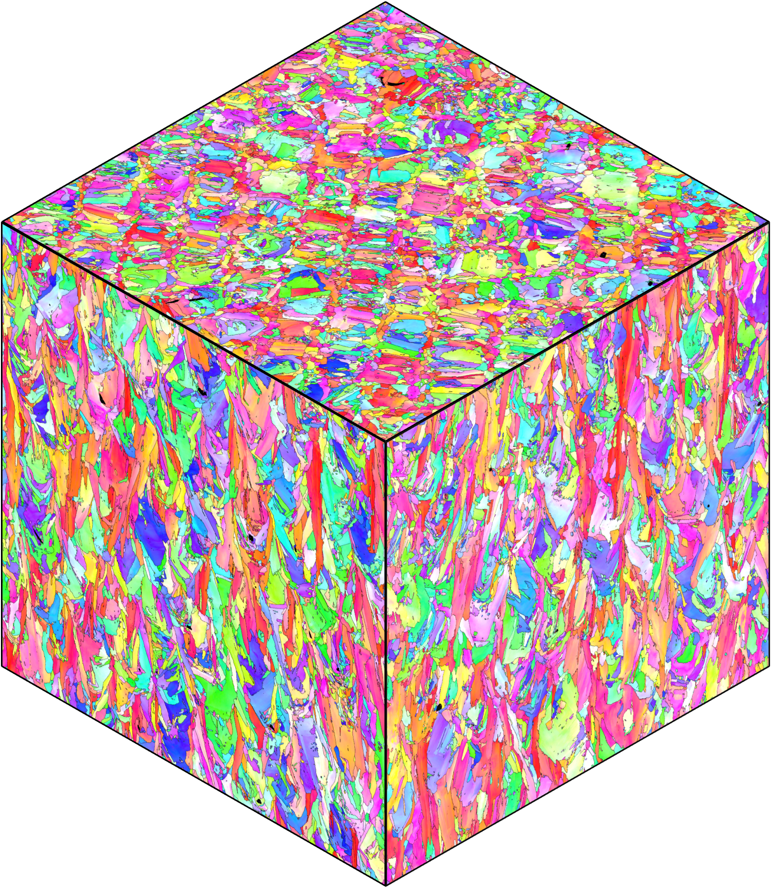
0° and 62 J/mm³
S plane
Build
L plane
M plane
Gas
Recoater
1 mm
Tensile
1 mm
Tensile
Notes:
Magnified views of top surface for a) 0 & 38 b) 0 & 62 and c) 60 &62. EBSD in three dimensions for d) … e) … and f) …. Magnified …. Of left surface … g) … h) … and i) …

Slide 2
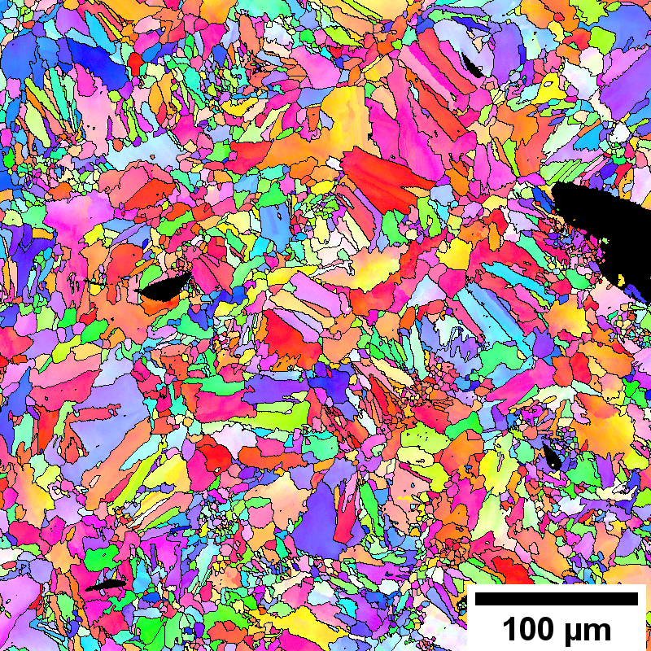
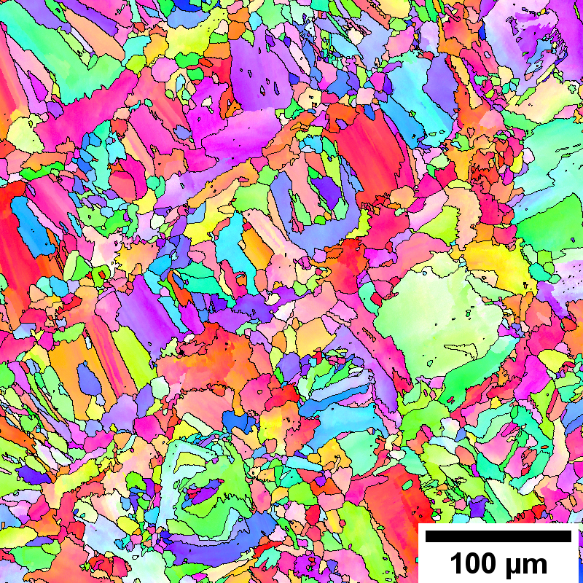
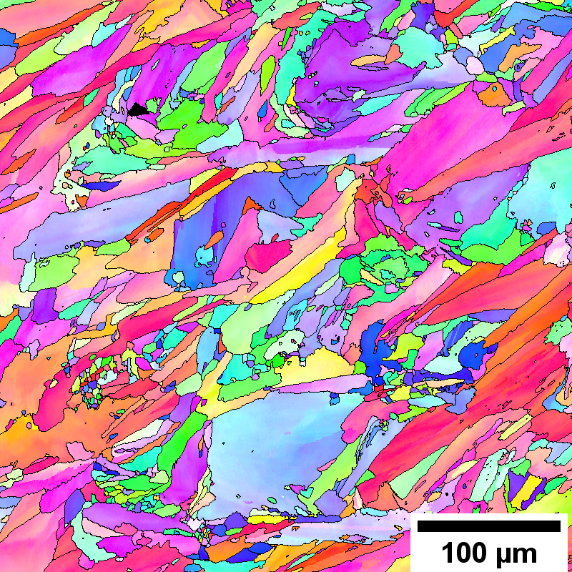
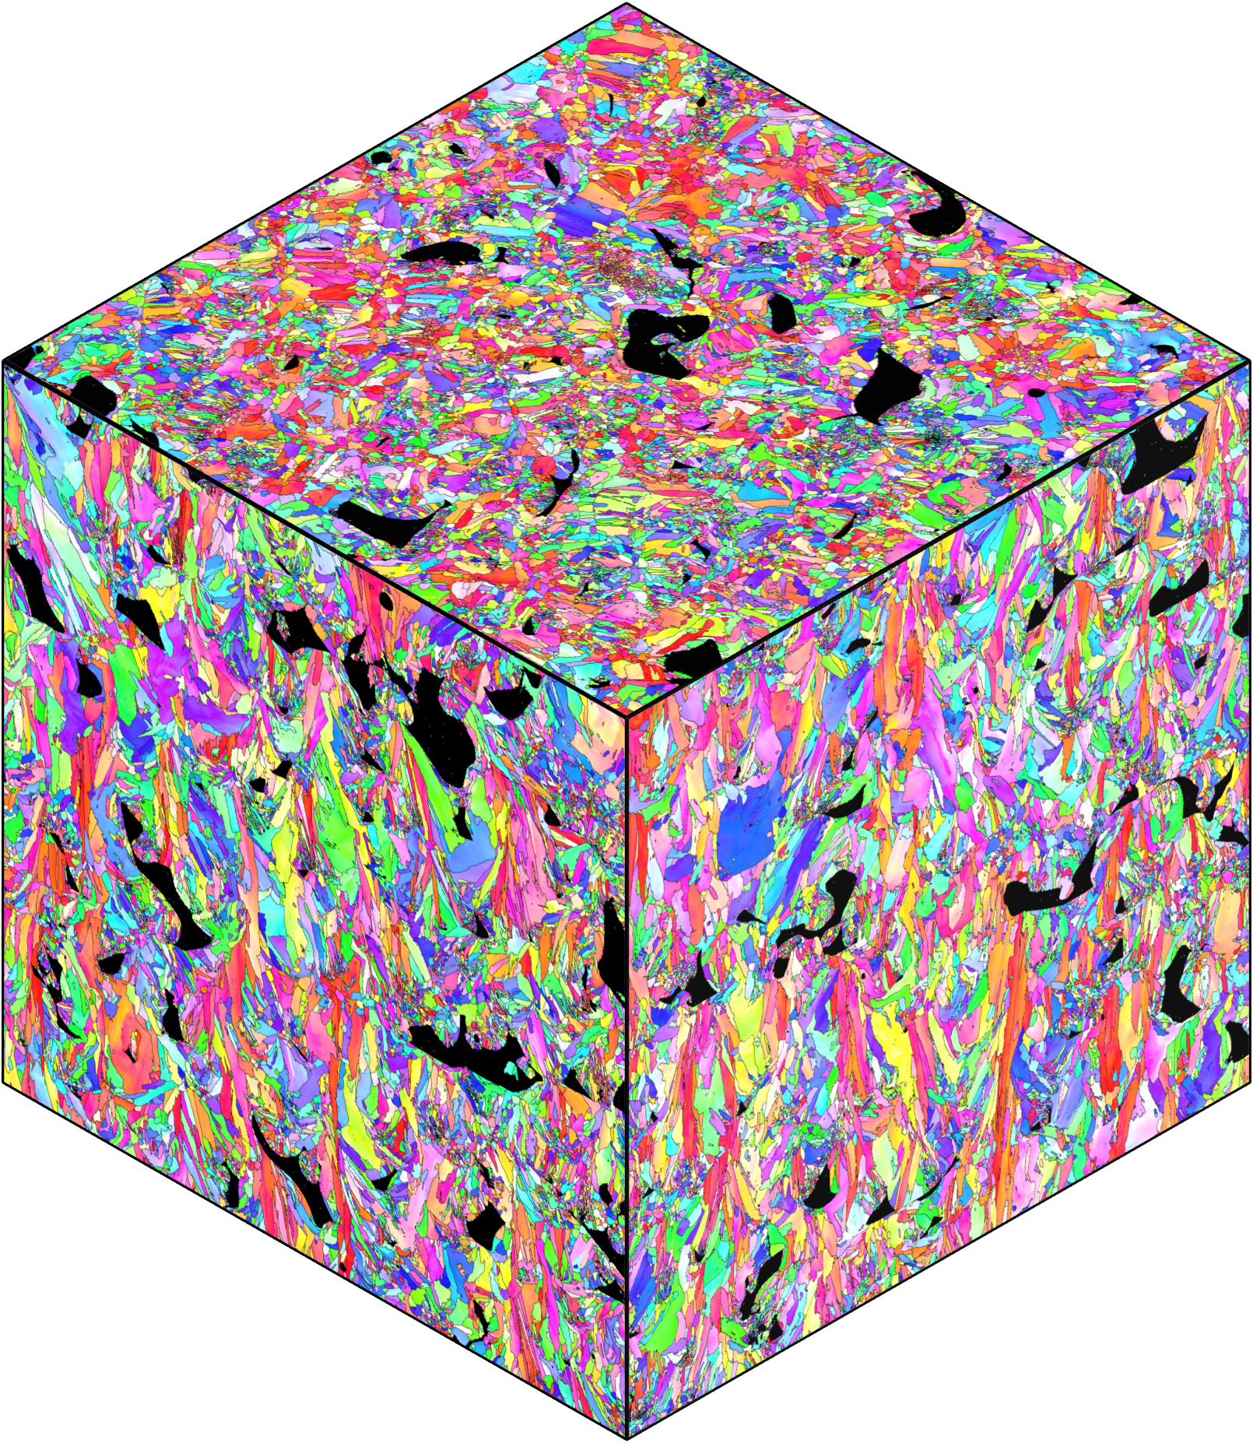
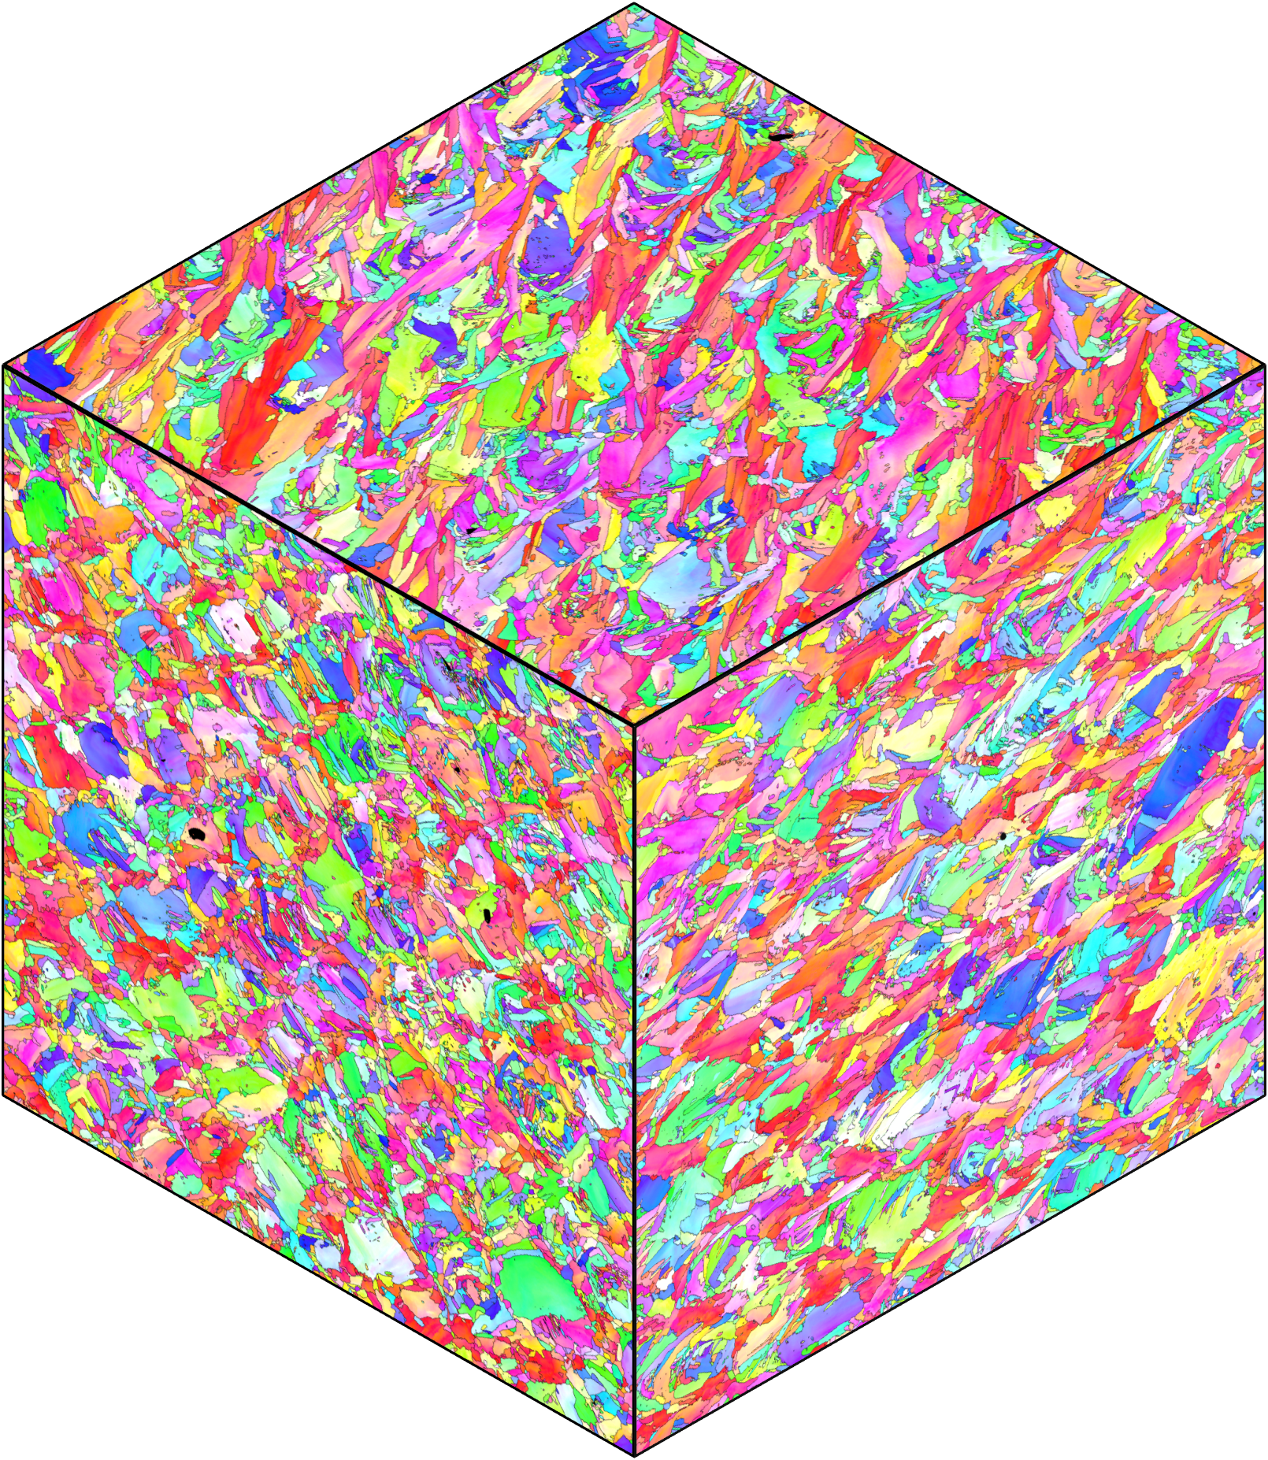
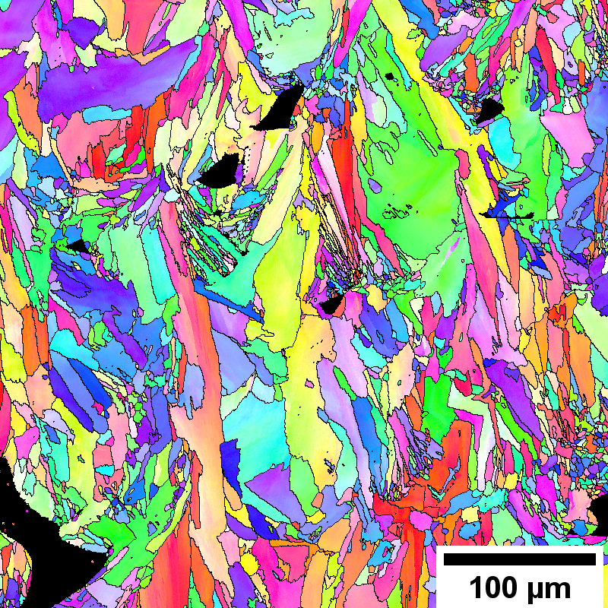
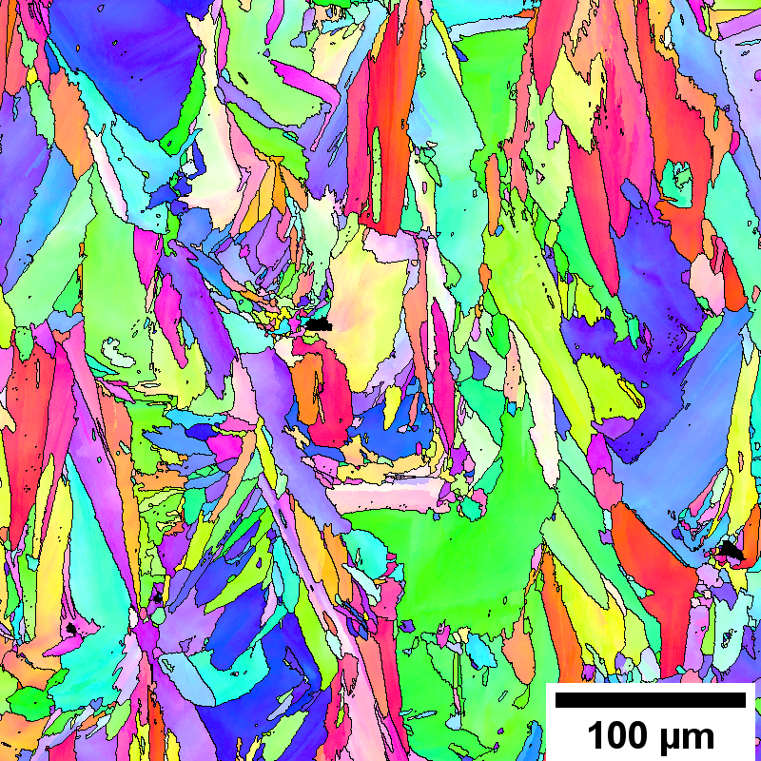
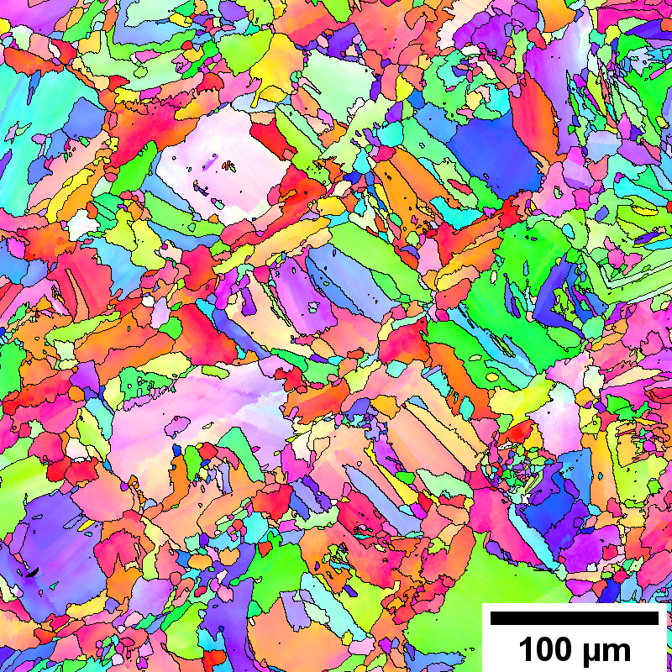
0° and 38 J/mm³
0° and 62 J/mm³
60° and 62 J/mm³
a)
b)
c)
BD
TD
BD
TD
BD
TD
d)
e)
f)
Build
Build
Build
Gas
Gas
Recoater
Recoater
Gas
Recoater
111
1 mm
Tensile
Tensile
001
101
g)
h)
i)
BD
TD
BD
TD
BD
TD
Notes:
Magnified views of top surface for a) 0 & 38 b) 0 & 62 and c) 60 &62. EBSD in three dimensions for d) … e) … and f) …. Magnified …. Of left surface … g) … h) … and i) …

